Slide 1
An overview on Computer Ports

Slide 2
Outline
Computer Port
Types of Port
Serial Port
Parallel Port
Virtual Port
Physical Port
USB Port

Slide 3

Port

Slide 4
PORT(cont.)
In computer hardware a port---
Is an interface between computer and peripheral devices
Allows computers to access external devices
Is an endpoint of communication
Uses: to connect monitor, webcam, speakers or other peripheral devices

Slide 5
Physical port
Physical ports---
Are used for connecting a computer through a cable to a peripheral device
Include:
->USB port (USB 2.0 or USB 3.0)
->ethernet port
->parallel port(DB25)

Slide 6
Virtual port
Virtual ports are---
Data gates that allow software application to use hardware resources
Example:
->Com port for Windows ->ACM port in Linux

Slide 7
PARALLEL PORTS
Parallel ports---
Send multiple bits at the same time
Use several sets of wires
Connect:
-> Printer
->Scanner
->CD burner ->External hard drives

Slide 8
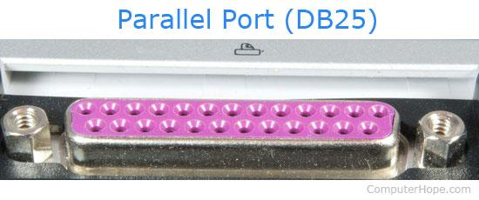
PARALLEL PORTS(contd.)
25 pins (13+12)
Female pins

Slide 9
SERIAL PORTS
Serial ports---
Send and receive single bit at a time
Use a single wire
Example:
-> PS/2 port
-> USB port

Slide 10
VGA PORT
VGA port---
Has 15 pins displayed on three rows
Is mainly used for connecting the monitor with the video adapter from the computer motherboard

Slide 11
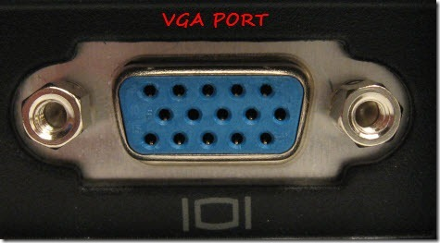
VGA PORT(contd.)

Slide 12
ETHERNET PORT
Ethernet/Internet port--
Was first introduced in 1980 to standardize the local area networks (LAN).
Uses RJ45 connectors

Slide 13
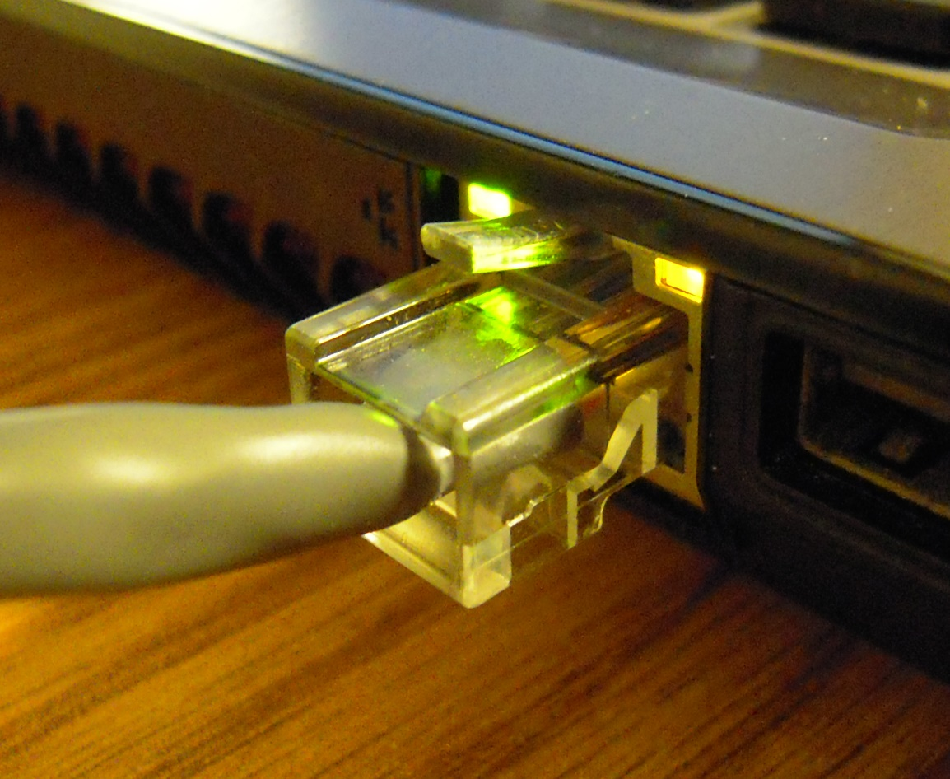
ETHERNET PORT(contd.)

Slide 14
USB PORT
Universal Serial Bus---
Used for :
connection, communication, and power supply between computers and electronic devices.
USB Types: Type-A, Type-B, Type-C

Slide 15
USB TYPE-A
USB type-A is:
Known as USB Standard-A
Is the original design for the USB standard
Flat and rectangular shape

Slide 16
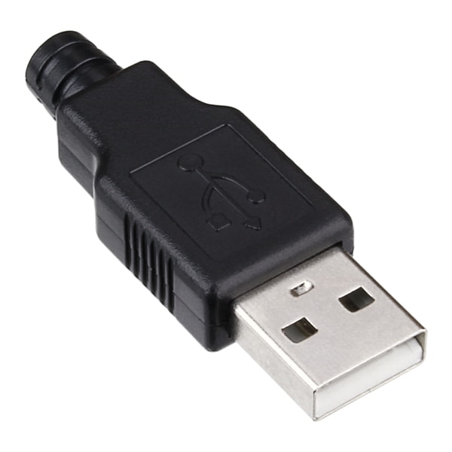
USB TYPE-A

Slide 17
USB TYPE-B
USB type-B is:
Used in printer, Arduino Board, a phone, or an external hard drive
The connector is known as Type B-male
On the peripheral device, the USB port is called Type B-female.

Slide 18
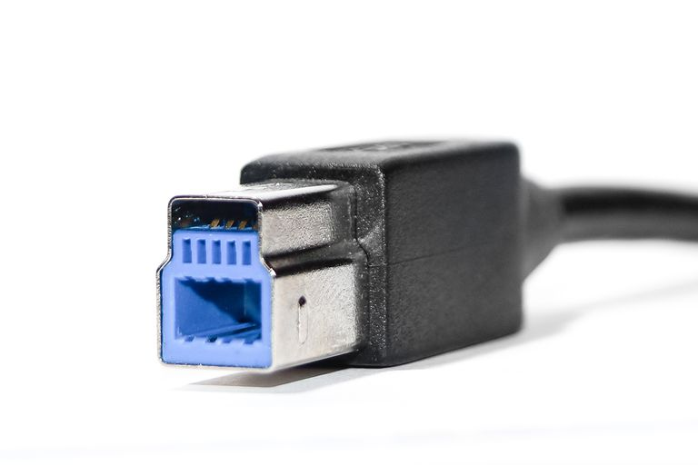
USB TYPE-B

Slide 19
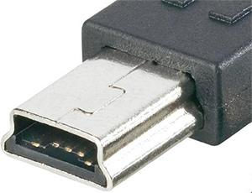
USB TYPE-B
Mini
mi

Slide 20
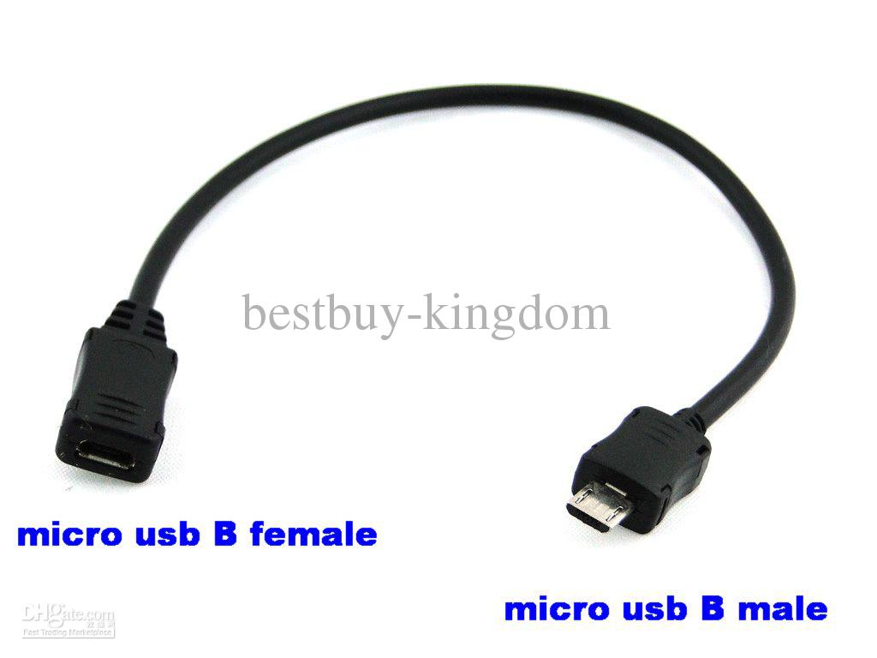
USB TYPE-B
Micro
mi

Slide 21
USB TYPE-C
USB type-C :
Called “USB-C”
Apple's latest 12-inch Macbook is the first notebook that incorporates a Type-C USB as its power port
It is just 8.4 mm by 2.6mm.

Slide 22
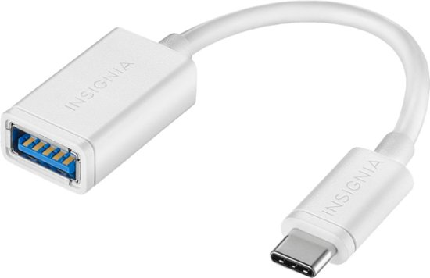
USB TYPE-C

Slide 23
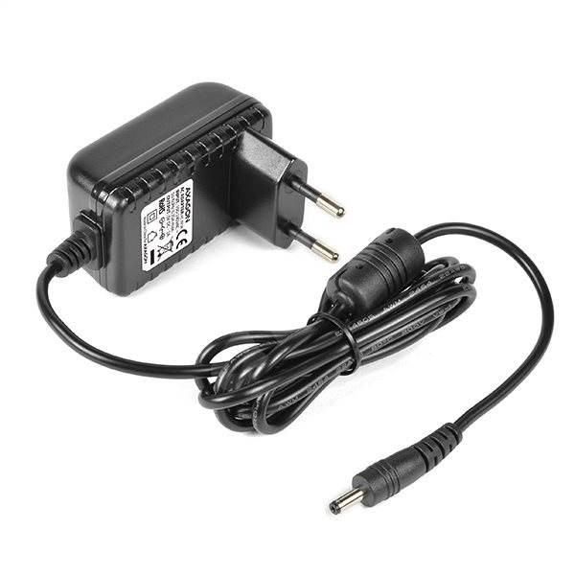
NOT USB

Slide 24
Thank You

